Slide 1

NITTE MEENAKSHI INSTITUTE OF TECHNOLOGY DEPARTMENT OF INFORMATION SCIENCE AND ENGINEERING
SUBMITTED BY: FACULTY:
AKSHATA ANJUTAGI 1NT19IS401 Dr . adithyashasthri
LAVANYA K 1NT19IS407 Dept of ise ,nmit

Slide 2
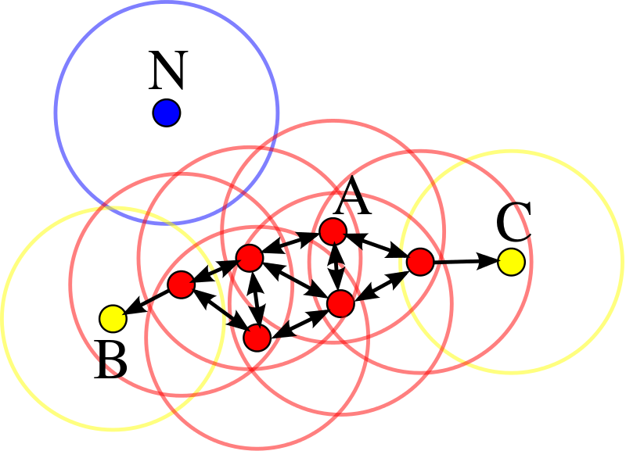
Density-based spatial clustering of applications with noise (DBSCAN) is a data clustering algorithm. It is a density-based clustering non-parametric algorithm given a set of points in some space, it groups together points that are closely packed together.
DBSCAN CLUSTERING ALGORITHM

Slide 3
DBSCAN algorithm Components
1.Epsilon
2.MinPts
3. Core Point
4. Border Point
5. Noise or outlier

Slide 4
ABSTRACT ALGORITHM
The DBSCAN algorithm can be abstracted into the following steps:
Find the points in the ε (eps) neighborhood of every point, and identify the core points with more than minPts neighbors.
Find the connected components of core points on the neighbor graph, ignoring all non-core points.
Assign each non-core point to a nearby cluster if the cluster is an ε (eps) neighbor, otherwise assign it to noise.

Slide 5
ALGORITHM
DBSCAN(DB, distFunc, eps, minPts) {
C := 0
for each point P in database DB {
if label(P) ≠ undefined then continue
Neighbors N := RangeQuery(DB, distFunc, P, eps)
if |N| < minPts then {
label(P) := Noise
continue
}
C := C + 1
label(P) := C
SeedSet S := N \ {P}
for each point Q in S {
if label(Q) = Noise then label(Q) := C
if label(Q) ≠ undefined then continue
label(Q) := C
Neighbors N := RangeQuery(DB, distFunc, Q, eps)
if |N| ≥ minPts then {
S := S ∪ N }
}
}
}

Slide 6
ADVANTAGES AND DISADVANTAGES
ADVANTAGES
DISADVANTAGES
Does not work well when dealing with clusters of varying densities.While DBSCAN is great at seperating high density clusters from low density clusters,DBSCAN struggles with clusters of similar density.
Struggles with high demensionality data.I know,this entire article I have stated how DBSCAN is great at contoring the data into different dimensions and shapes.However, DBSCAN can only go so far, if given data with too many dimensions, DBSCAN suffers.
Is great at separating clusters of high density versus clusters of low density within a given dataset.
Is great with handling outliers within the dataset

Slide 7
THANK YOU

